Slide 1
100s Times
More Deaths
Not Wearing Face Mask

Slide 2
COVID-19
“Not wearing face mask or face shield for everyone in the general public” may even cause up to 1000 times more deaths under the worst case scenario.

Slide 3
2003 SARS
In 2003, Hong Kong cases per million was 64 times and deaths per million was 165 times of China.
Hong Kong people did not know the importance of face mask and face shield and learned the lesson.

Slide 4
2003 SARS
Countries or Region | deaths | Deaths per million
China (Mainland) | 349 | 0.24
Hong Kong | 299 | 40.20
Taiwan | 73 | 3.07
Canada | 43 | 1.13
Singapore | 33 | 5.68

Slide 5
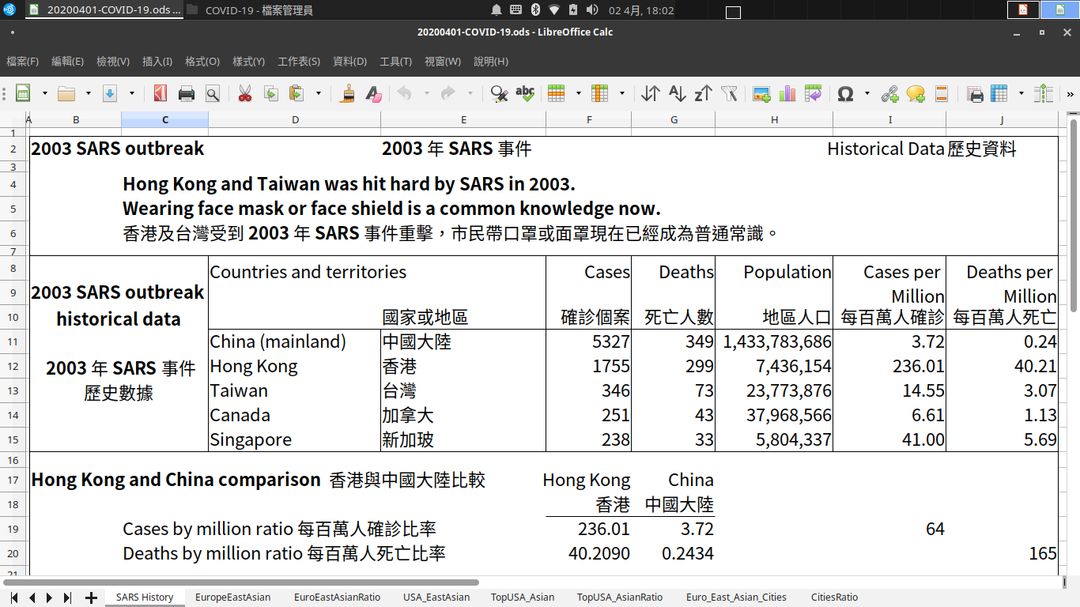

Slide 6
2003 SARS
Hong Kong has been hit hard by 2003 SARS
Wearing face mask for everyone is now a common knowledge

Slide 7
COVID-19 Hong Kong Situation
Unlike 2003 SARS, this time everyone in Hong Kong wears face mask during COVID-19.
By using the same ratio of 2003 SARS as a comparison to China, if everyone in Hong Kong does not wear mask, the number of deaths could have been more than 2000. (3295 * 299 / 349 = 2823)
So far, there are only 4 deaths in Hong Kong, this is several hundreds of times better than expected.

Slide 8
COVID-19 Statistics
The cases per million and deaths per million calculation up to 2020-04-01

Slide 9
COVID-19 Statistics
No Face Mask for General Public
  Italy 13115 deaths
  Spain 9387 deaths
  France 4032 deaths
Face Mask Everyone
  Hong Kong 4 deaths
  Taiwan 5 deaths

Slide 10
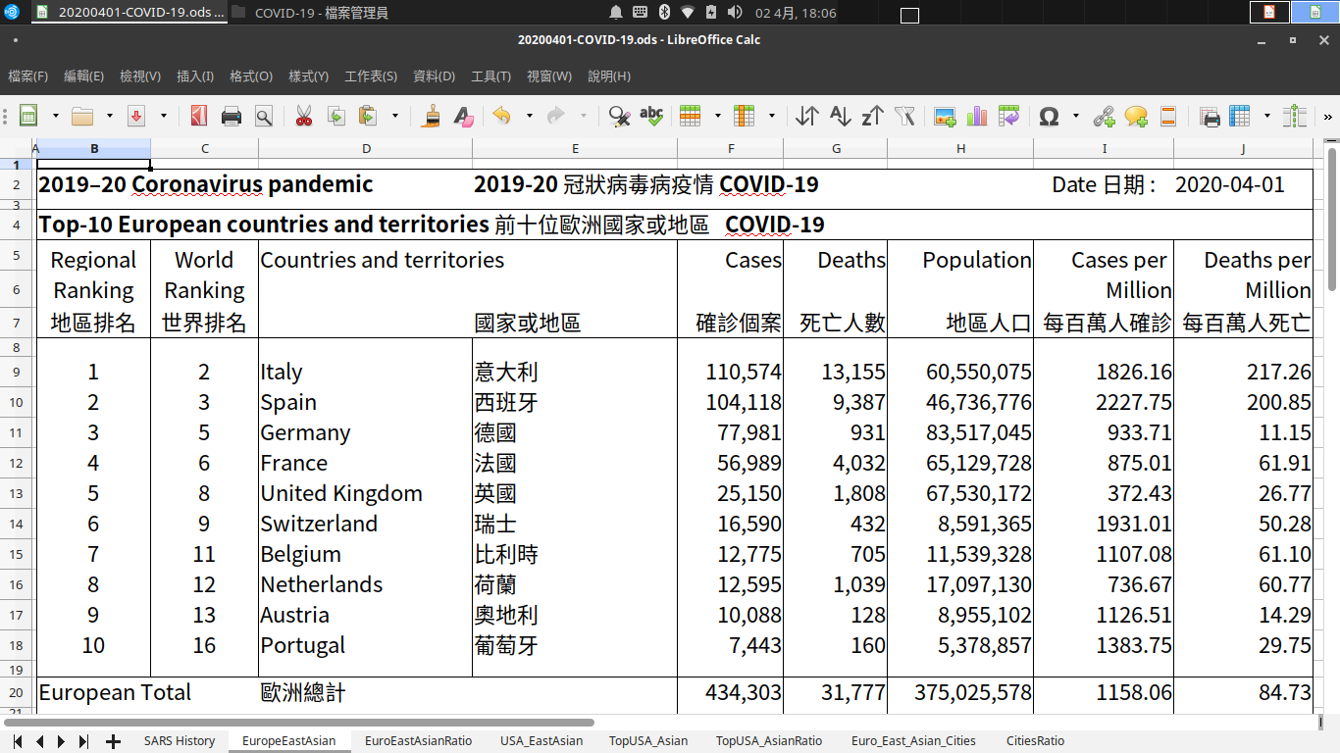

Slide 11
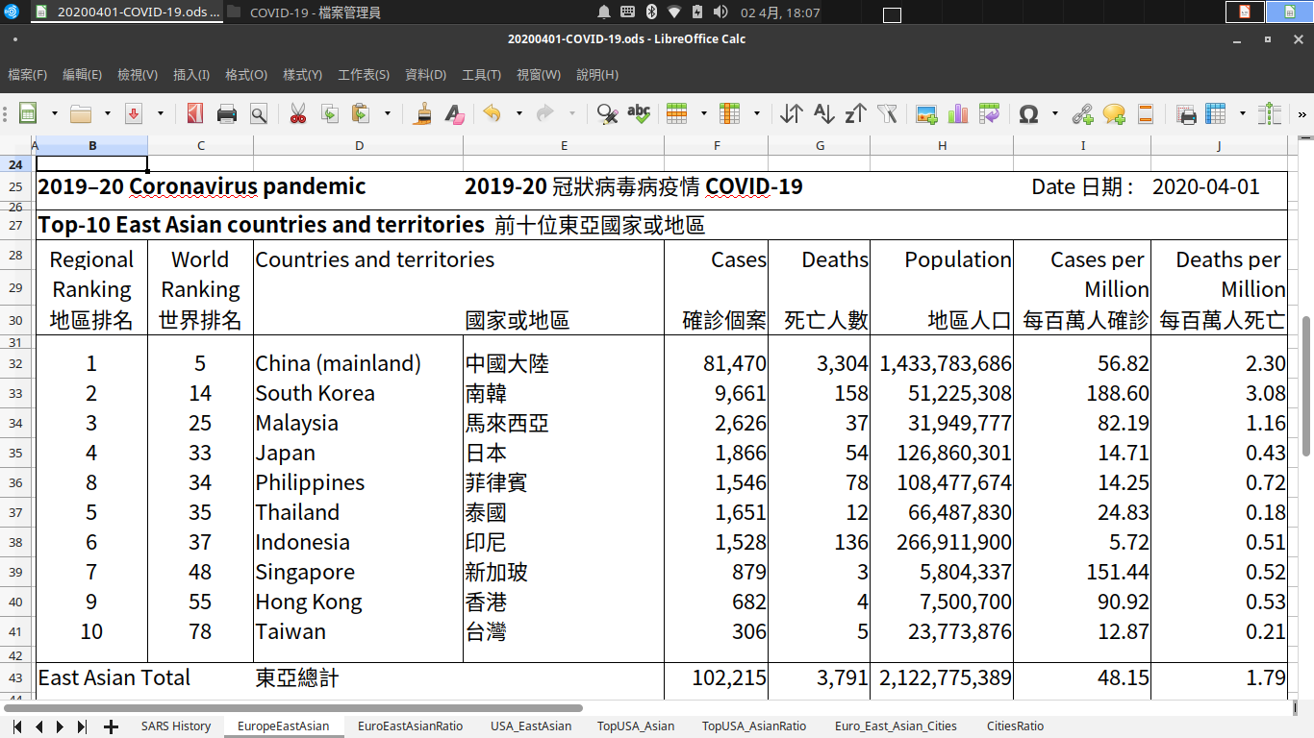

Slide 12
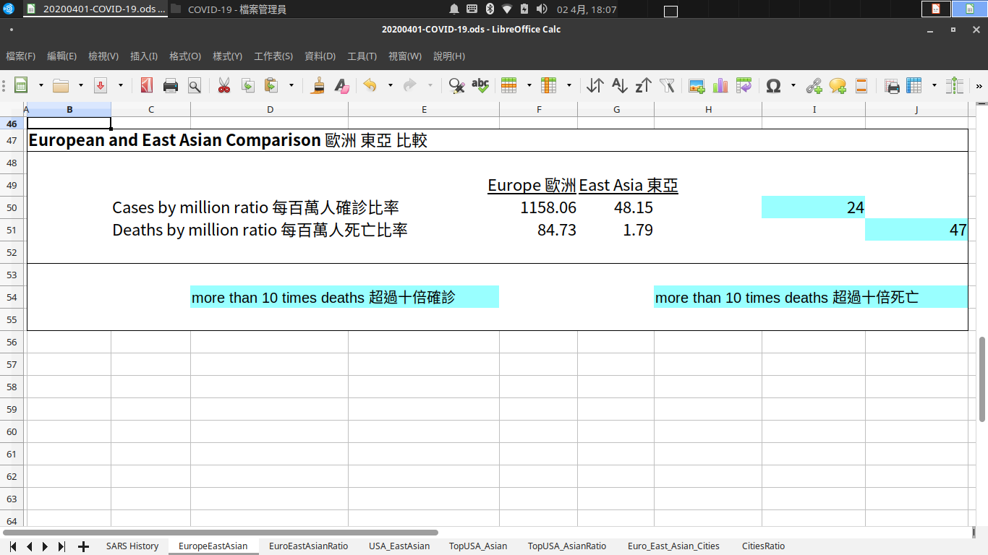

Slide 13
COVID-19
European Top-10 vs East Asian Top-10
24 Times cases
47 Times deaths

Slide 14
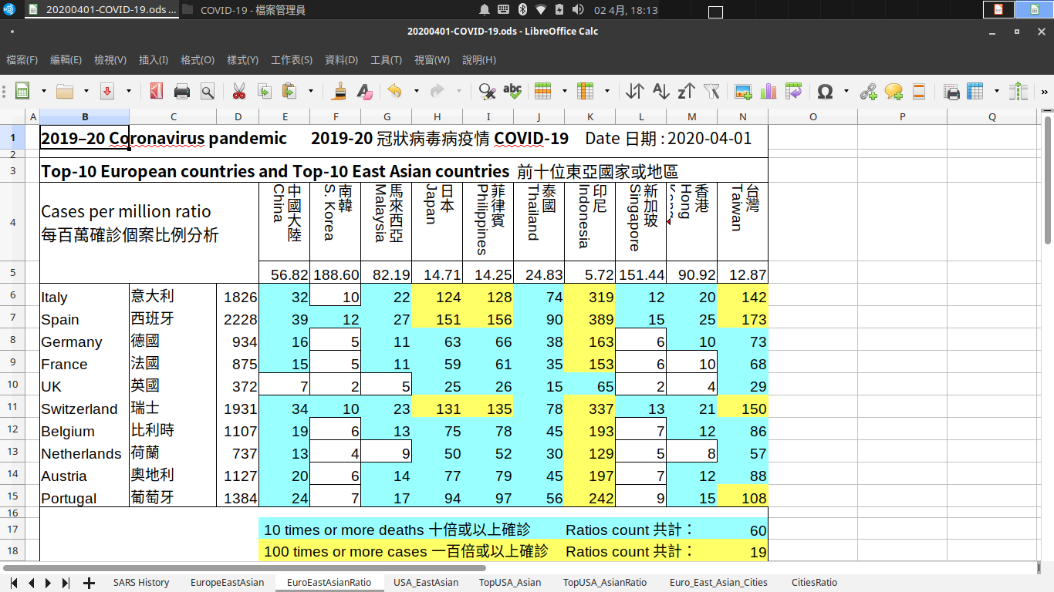

Slide 15
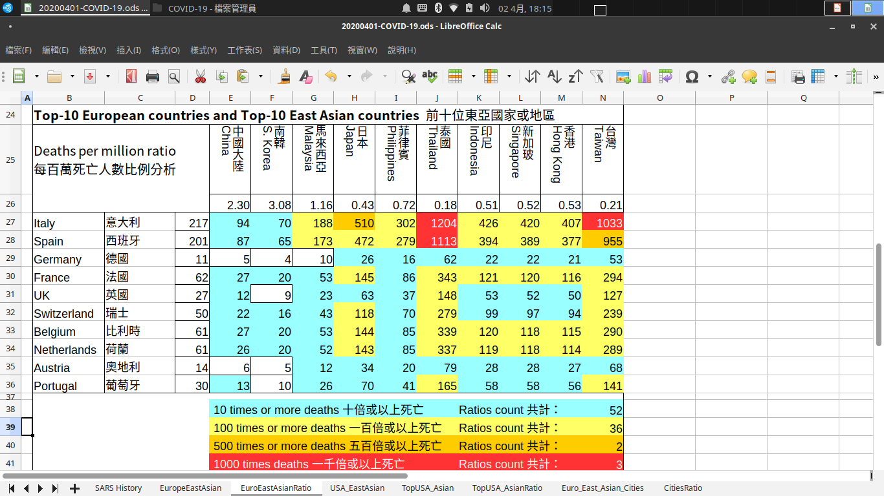

Slide 16
COVID-19
Italy vs Taiwan :
142 Times cases and 1033 Times deaths
Italy vs Thailand :
74 Times cases and 1204 Times deaths
Italy vs Hong Kong :
20 Times cases and 407 Times deaths

Slide 17
COVID-19
Spain vs Taiwan :
173 Times cases and 955 Times deaths
Spain vs Thailand :
90 Times cases and 1204 Times deaths
Spain vs Hong Kong :
25 Times cases and 377 Times deaths

Slide 18
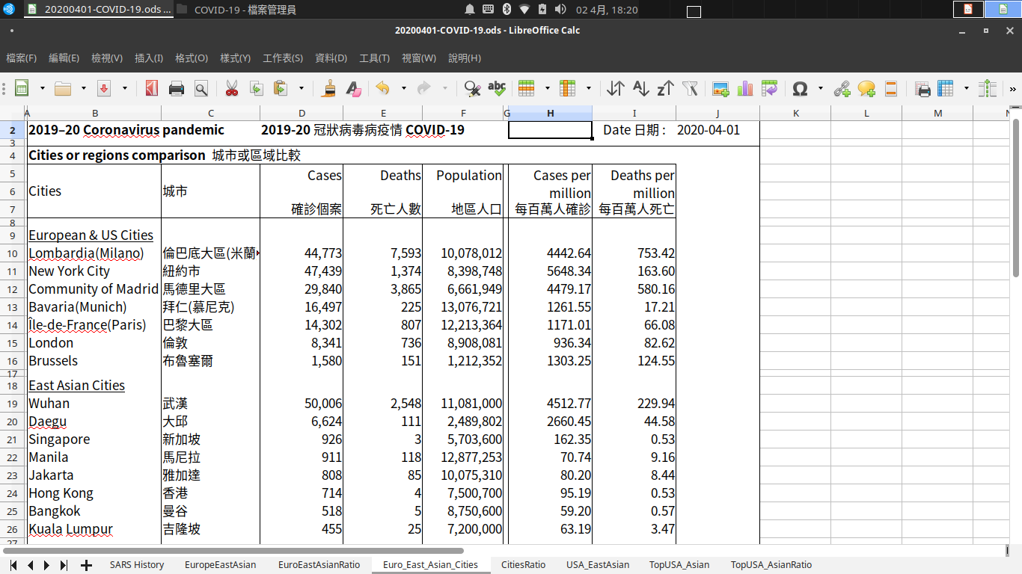

Slide 19
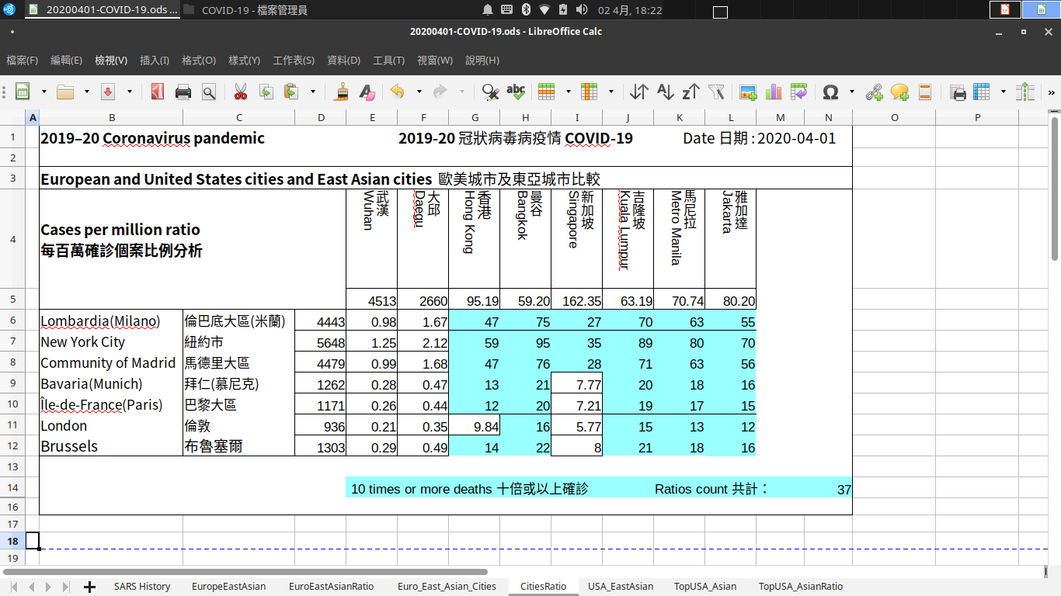

Slide 20
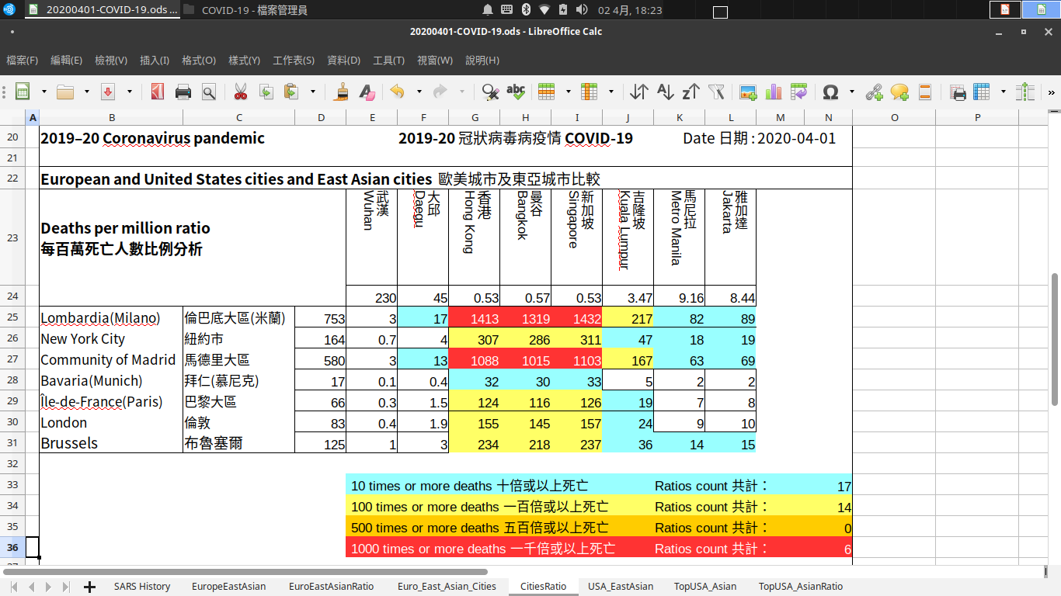

Slide 21
COVID-19
Lombardia vs Hong Kong :
47 Times cases and 1413 Times deaths
Lombardia vs Bangkok :
75 Times cases and 1319 Times deaths
Lombardia vs Singapore :
27 Times cases and 1432 Times deaths

Slide 22
COVID-19
Madrid vs Hong Kong :
47 Times cases and 1008 Times deaths
Madrid vs Bangkok :
76 Times cases and 1015 Times deaths
Madrid vs Singapore :
28 Times cases and 1103 Times deaths

Slide 23
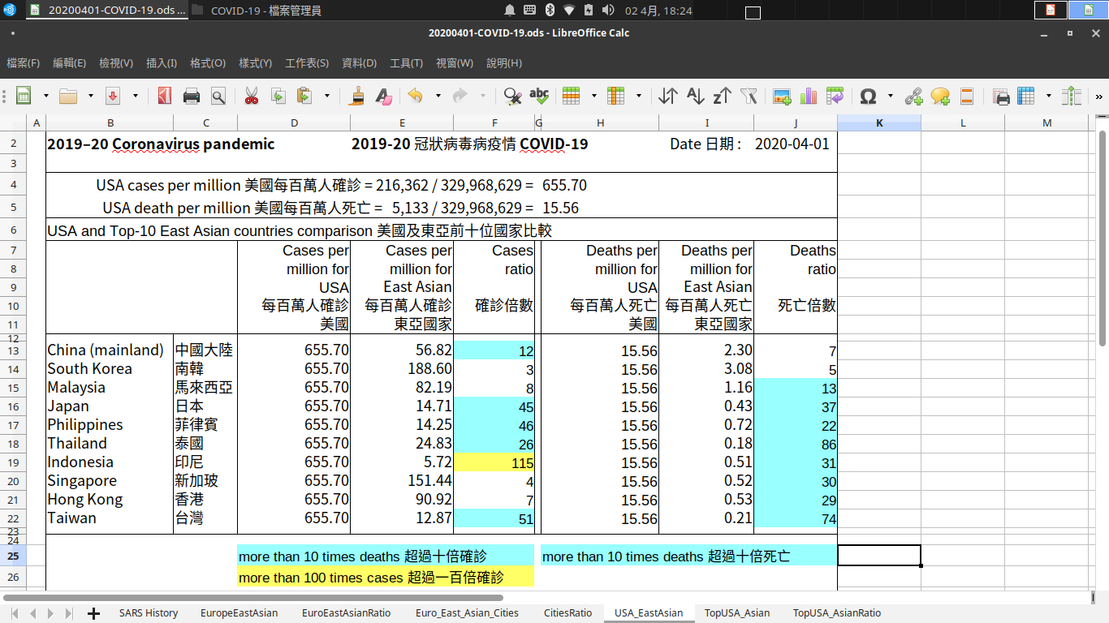

Slide 24
COVID-19 USA vs East Asia
USA vs Taiwan :
51 Times cases and 74 Times deaths
USA vs Thailand :
26 Times cases and 86 Times deaths
USA vs Hong Kong :
7 Times cases and 29 Times deaths

Slide 25
COVID-19
USA Top-10 Average
vs
East Asian Top-10 Average
20 Times cases and 11 Times deaths

Slide 26
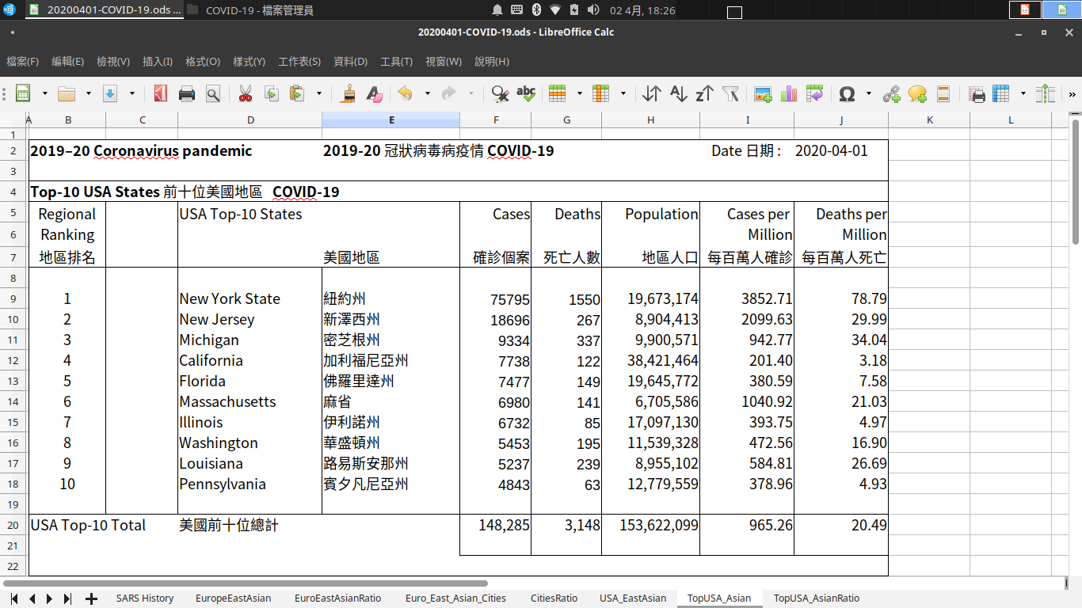

Slide 27
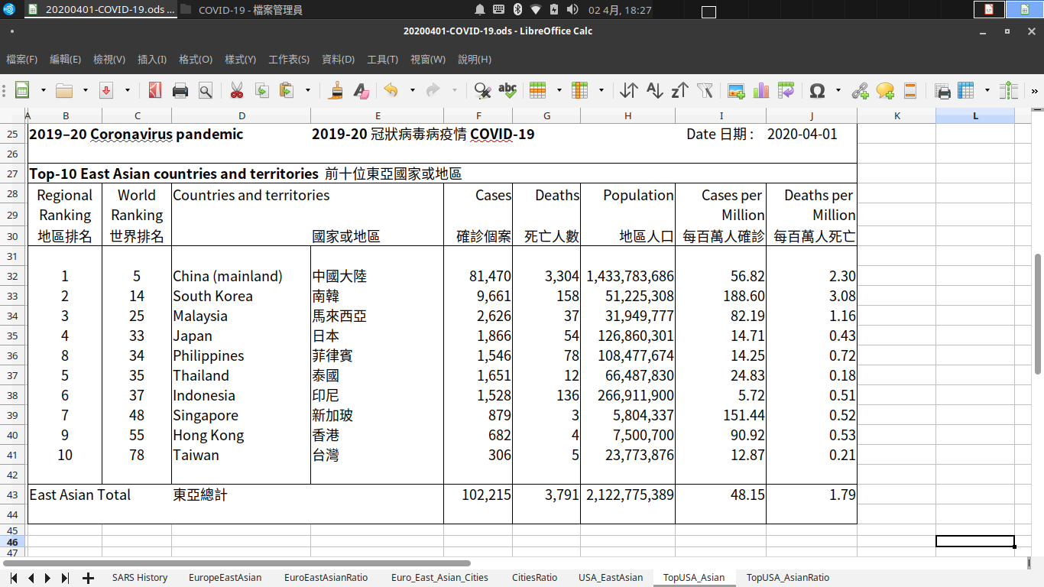

Slide 28
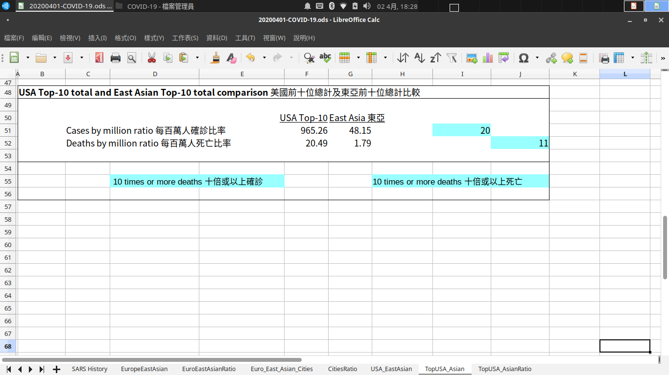

Slide 29
COVID-19
New York State vs Taiwan :
299 Times cases and 375 Times deaths
New York City vs Hong Kong :
59 Times cases and 307 Times deaths
New York’s number is rising quickly, I think we will see deaths toll more than 500 times or even 1000 times of Taiwan and Hong Kong very soon.

Slide 30
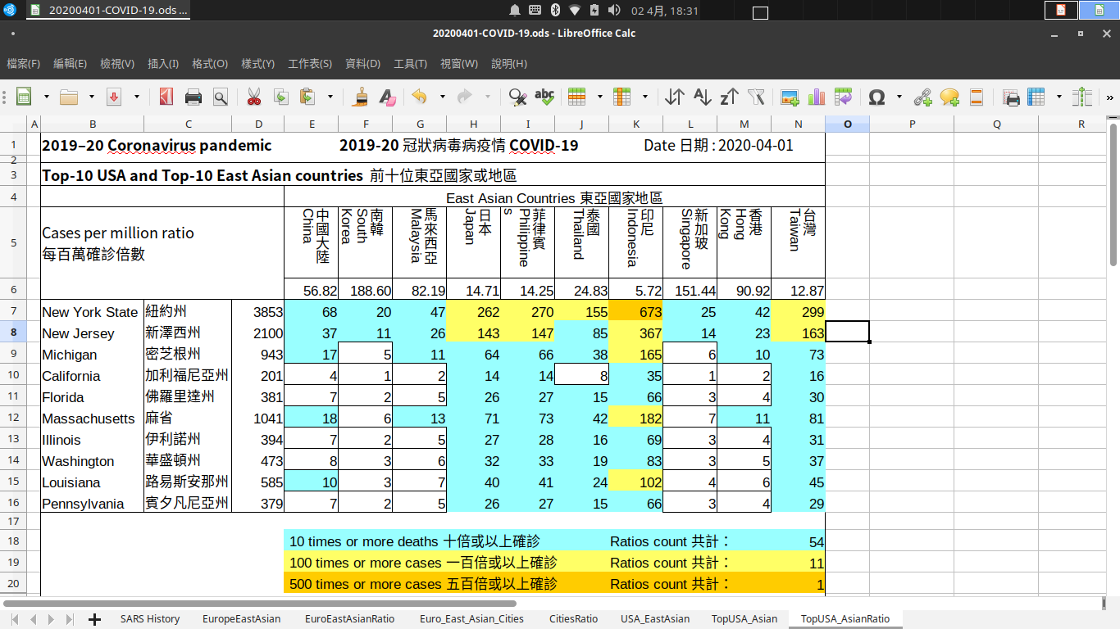

Slide 31
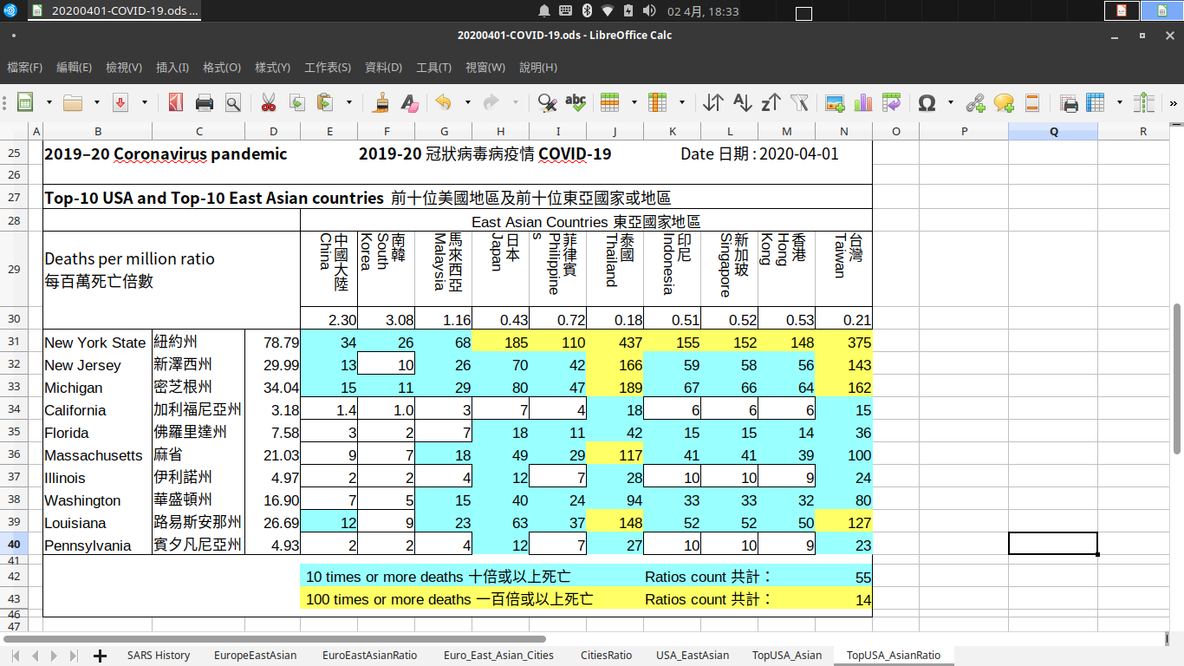

Slide 32
COVID-19 0 Death So Far
Vietnam : 227 cases and 0 death
Cambodia : 114 cases and 0 death
Bermuda : 35 cases and 0 death

Slide 33
Government Policy Example : Vietnam
Mandatory requirement for all citizens to wear face masks in the outdoors.
Not follow this rule will be fined.

Slide 34
Government Policy Example : Czech Republic
Face masks now required at all Prague shops, offices under fine of up to 20,000 crowns

Slide 35
Example of community responses
In January 2020, there was only one face mask factory in Hong Kong.
In April 2020, there are over 10 new face mask factories starting production.

Slide 36
Example of community responses
Toronto's Michael Garron Hospital hoping to get the entire East End community to wear masks within 6 feet of one another! Enlisting those with sewing skills to help produce the masks.

Slide 37
Example of community responses
From former first lady to Boy Scouts, Czechs ramp up home mask production

Slide 38
Social Distancing and Face Mask
Social Distancing is NO REPLACEMENT for face masks.
Rely solely on social distancing alone may cause 100s or even 1000 times more deaths than those use both social distancing and face masks together.

Slide 39
Please wear face mask or shield
Getting people to wear a mask in public may save millions of lives

Slide 40
Thank you!
Please see the description for links to the LibreOffice Calc file

